Slide 1
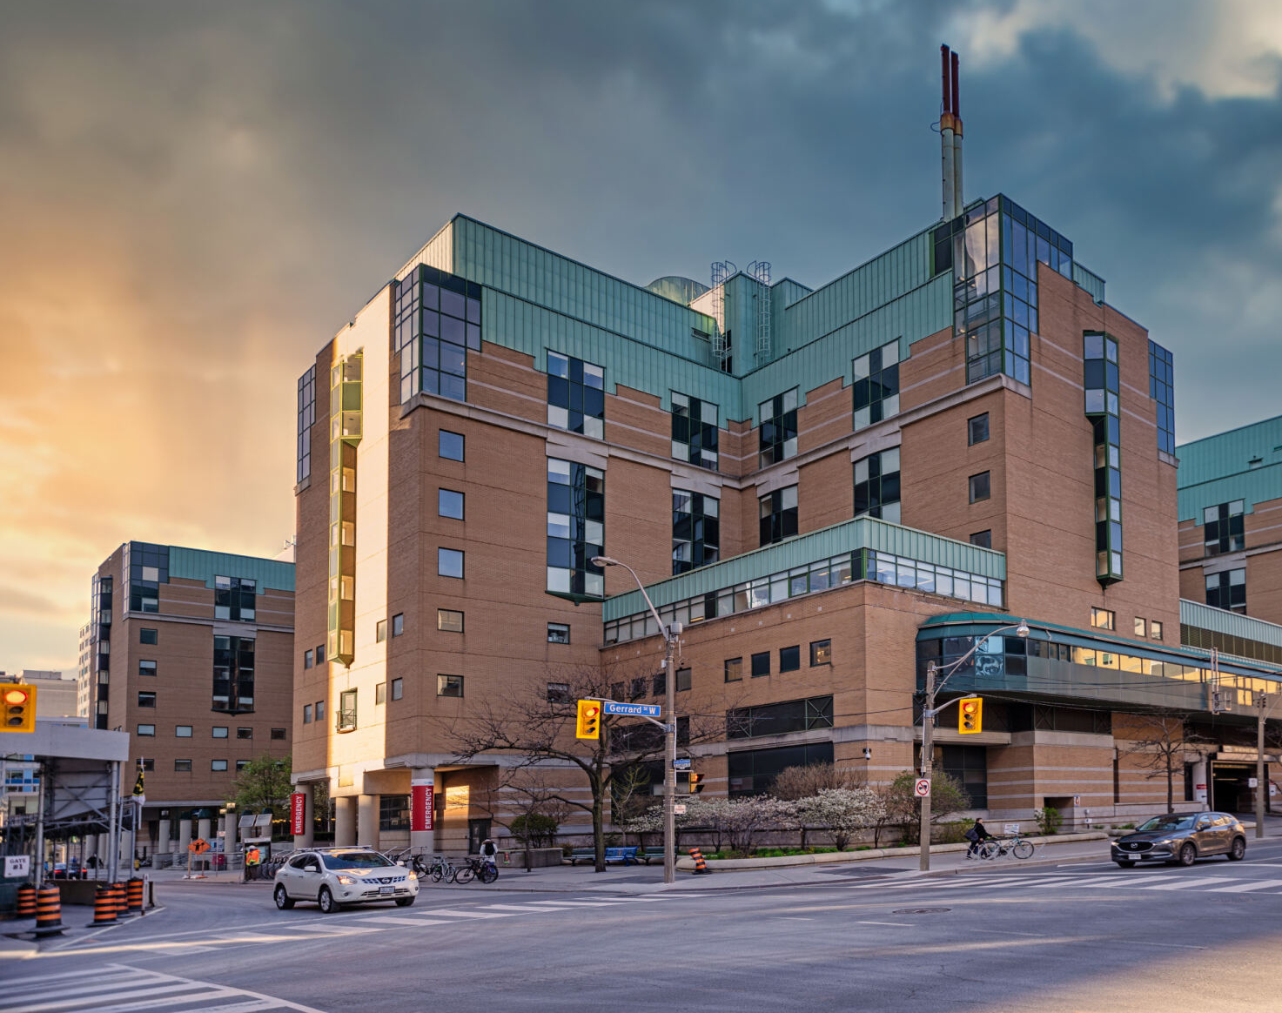

Blinatumomab and Childhood B-ALL:
AALL1731, its Impact on Standard
Treatment, and Unanswered Questions
Sumit Gupta, MD, PhD
Professor, Hospital for Sick Children and University of Toronto, Toronto, Canada
Vice-Chair, Clinical Trials, ALL Committee, Children’s Oncology Group
Society for Clinical Trials, 46th Annual Meeting, Vancouver, Canada
May 20th, 2025

Slide 2
Disclosures
Speakers Bureau/honoraria: Amgen
Consulting fees: Amgen, Jazz

Slide 3
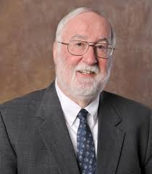

Slide 4
Outline
A history of childhood acute lymphoblastic leukemia (ALL)
Basics of COG approach to the treatment of pediatric ALL
Why study blinatumomab in Standard Risk (SR) B-ALL?
AALL1731
Impact on current standards of care
Unanswered questions and future directions

Slide 5
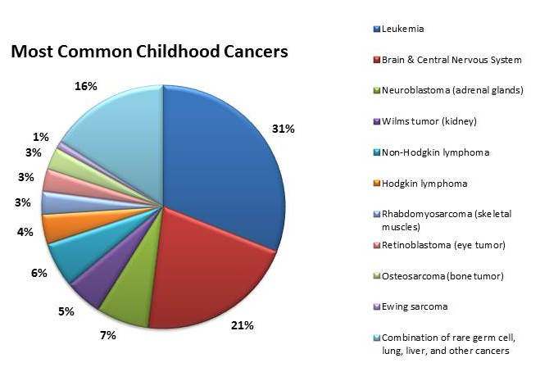
About 3,000 of pediatric ALL in the US annually

Slide 6
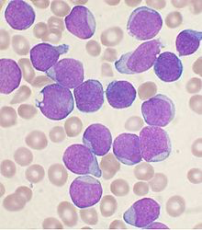

Slide 7


Slide 8
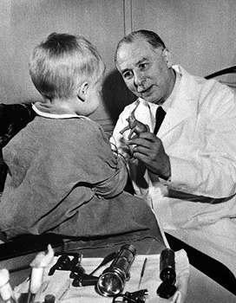
1947 – First ever remission in childhood leukemia achieved using a single drug. Report of 10 cases published
1958 – Demonstration that combination chemotherapy causes remissions in childhood leukemia, with some patients achieving long term

Slide 9
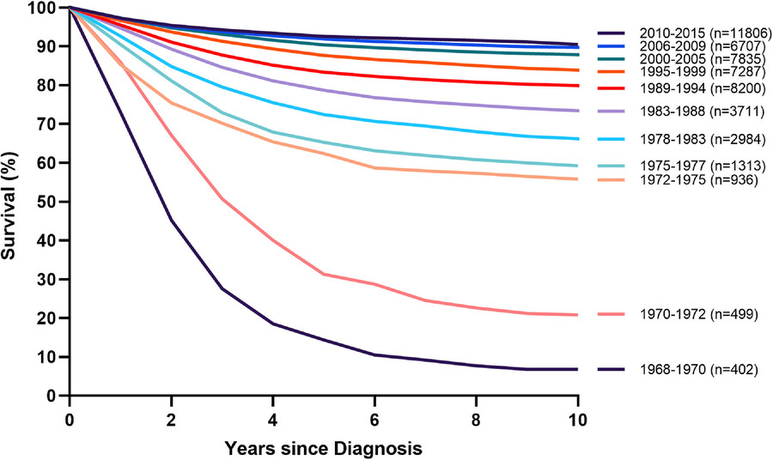
Pediatric B-cell Acute Lymphoblastic Leukemia
Major progress over the last 5 decades
Not because of new drugs!

Slide 10
Vincristine – 1963
Doxorubicin – 1974
Aspariginase – 1953
Cyclophosphomide – 1959
Cytarabine – 1969
6-Mercaptopurine – 1953
Methotrexate - 1953

Slide 11
Pediatric B-cell Acute Lymphoblastic Leukemia
Major progress over the last 5 decades
Not because of new drugs!
Instead, due to series of well-designed clinical trials identifying more effective combinations of traditional chemotherapy, improved supportive care, and risk stratification

Slide 12
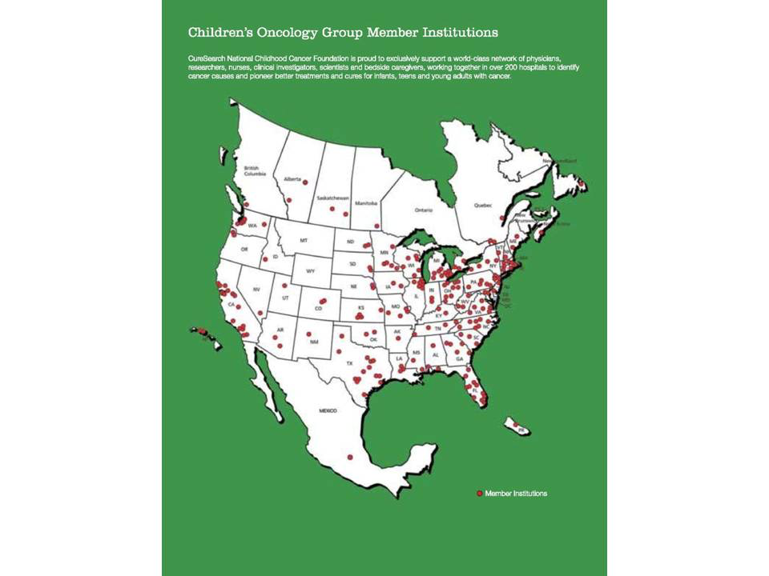
Overview
Background
POHEP Unit
Benefits
Achievements to date
Budget Proposal
Questions
4/5

Slide 13
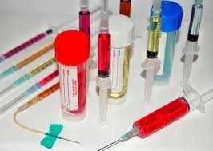
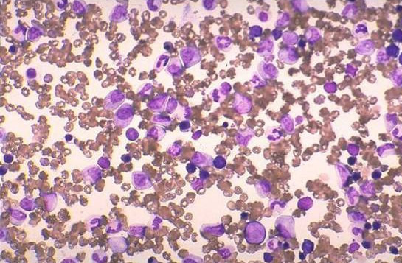
SUPPORTIVE CARE
Disease
Aggression
Treatment
Intensity
Disease
Aggression
Treatment
Intensity
Disease
Aggression
Treatment
Intensity
Disease
Aggression
Treatment
Intensity
ICU
Antibiotics
Specialists
Transfusion
RISK STRATIFICATION

Slide 14
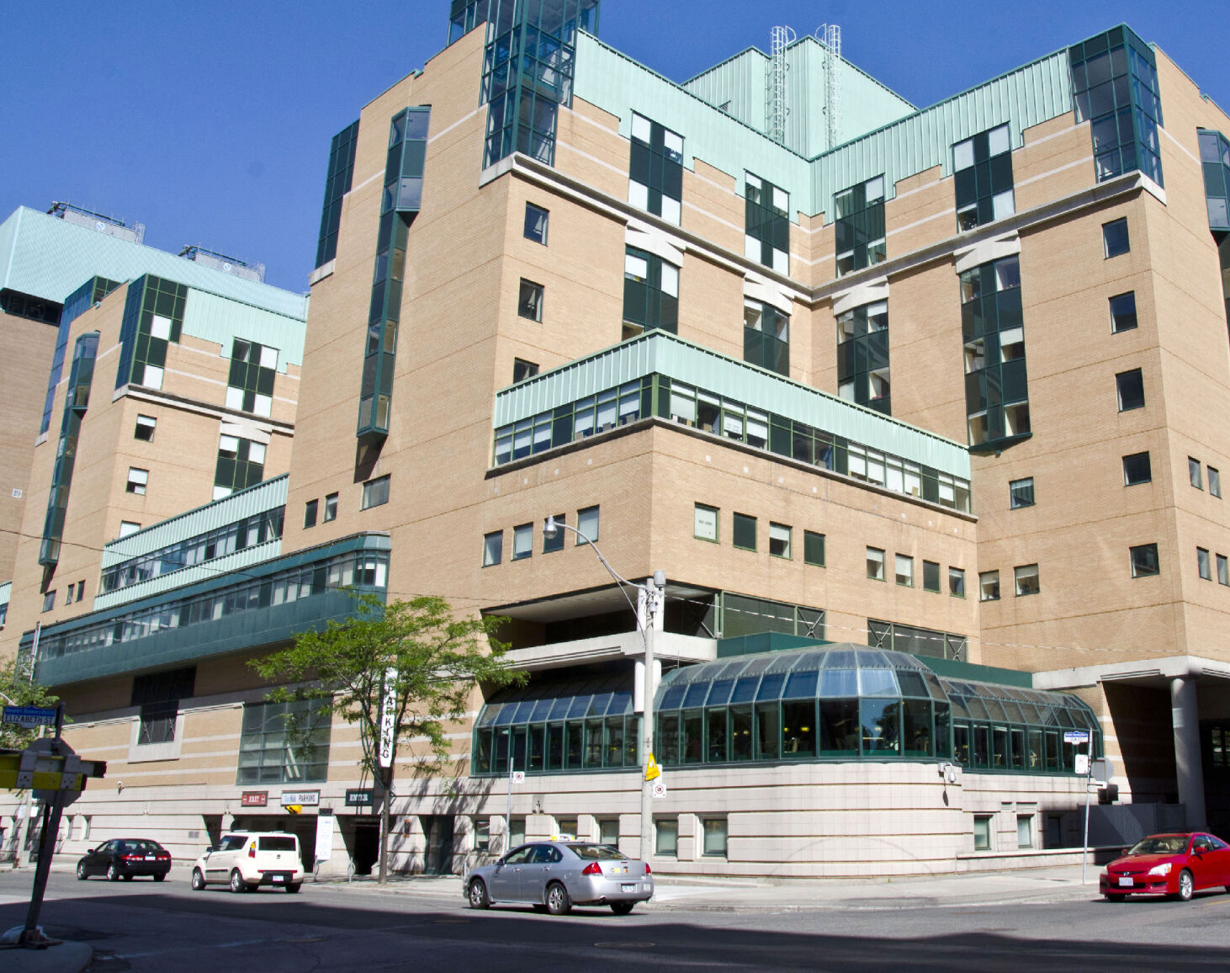
Basics of COG Approach to ALL

Slide 15
Standard Risk (SR) B-ALL
Children ages 1-9 years at diagnosis and with a presenting WBC count <50
Treated with 8-10 months of moderate to high intensity chemotherapy and then 2 years of low intensity oral chemo (i.e. Maintenance)
Use sophisticated risk stratification to determine who’s chemo backbone needs to be less intense or more intense
  CNS status
  Leukemia cytogenetics
  Response to first month of therapy (Induction)

Slide 16
  Common elements to most ALL protocols include Induction, Post-Induction therapy that includes some form of intensification, and Maintenance therapy
Standard Risk
High Risk
3 drug Induction
4 drug Induction
EOI BM MRD positivity
Unfavorable cytogenetics
Standard Consolidation
VCR x 1, 4 weeks 6MP, weekly IT MTX
Augmented Consolidation
(Longer duration; Extra VCR +PEG)
IM1 with Escalating MTX
IM1 with HD MTX x 4
Delayed Intensification (IIa+IIb)
Delayed Intensification (IIa+IIb)
(extra VCR +PEG in IIb)
IM2 with Escalating MTX
IM2 with Escalating MTX
Maintenance*
(with VCR/Dex pulses)
Maintenance*
(with VCR/Steroid pulses)

Slide 17
Excellent outcomes among SR patients, particularly the SR-Favourable subset
  SR-favorable/low
    CNS 1/2
    Favorable genetics (ETV6-RUNX1 or Double Trisomies 4 and 10)
    Day 8 peripheral blood MRD <1%
    Day 29 BM MRD <0.01%
  5-year EFS 96.4% (>95%)
  Accounts for 35% of NCI SR kids!
Angiolillo et al. JCO. 2021 Schore et al. Leukemia. 2023

Slide 18
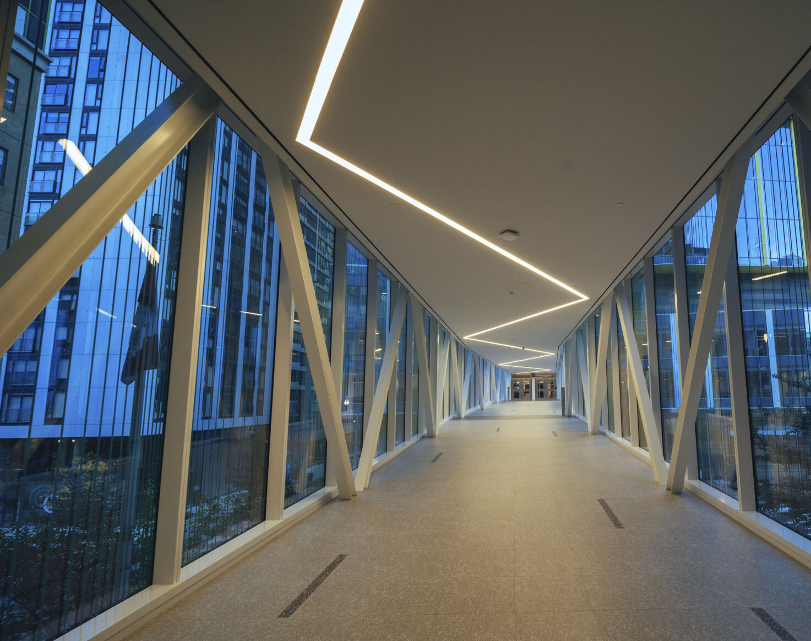
Why Study Blinatumomab in SR-ALL?

Slide 19
Recent plateau in progress
Overall survival in patients treated on COG and legacy trials
Raetz EA et al. PBC. 2023

Slide 20
Further progress in pediatric B-ALL has stalled
AALL0932
(2010-2018)
AALL1131
(2012-2017)
∅
Improved outcomes
∅
Improved outcomes
Infectious toxicity
Further intensification of chemotherapy will not improve outcomes
Angiolillo et al. Blood. 2017
Salzer and Burke et al. Cancer. 2018

Slide 21
Why study a novel agent in SR B-ALL?
Despite the overall good outcome, half of relapses still occurred among NCI SR patient
Mattano et al. JCO. 2021
Maloney. JCO. 2020
Angiolillo et al. JCO. 2021
More Asparaginase?
AALL0331
Intensified Consolidation?
AALL0331
Higher dose MTX in Maintenance?
AALL0932
Thus, further improvements likely required novel agents
Given overall favorable outcome, any such agent must have had good evidence of anti leukemia efficacy and a favorable toxicity profile

Slide 22
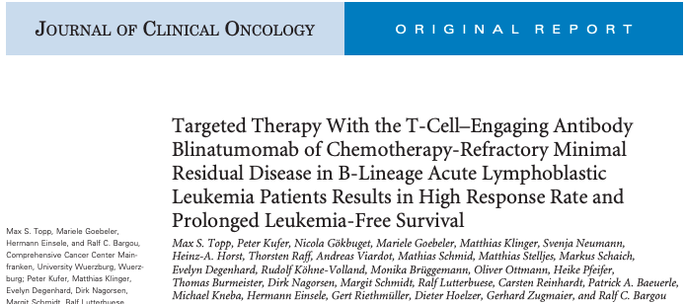
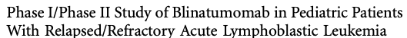
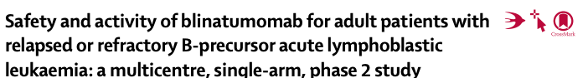
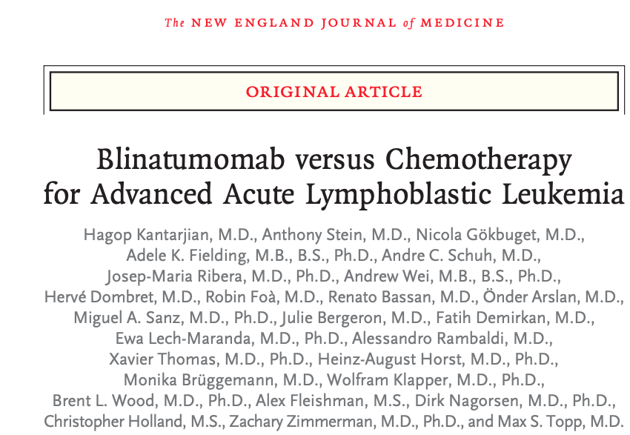
Agent with distinct mechanism of action and toxicity profile
von Stackleberg et al. JCO. 2016
Topp et al. JCO. 2011
Topp et al. Lancet Oncol. 2015
Kantarjian et al. NEJM. 2017
Blinatumomab selected as investigational agent for AALL1731

Slide 23
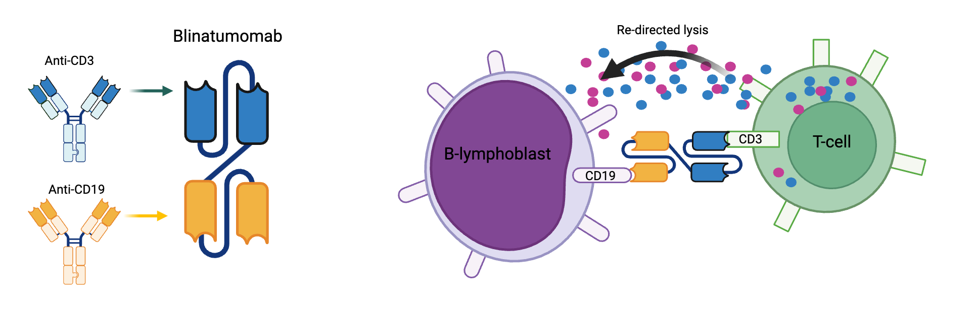
Blinatumomab mechanism of action

Slide 24
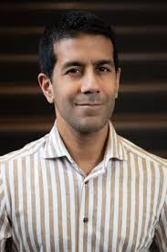
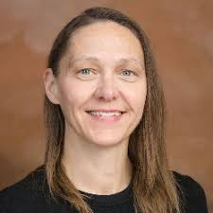
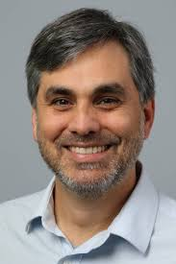
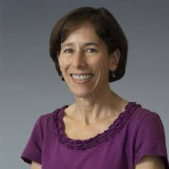


AALL1731
COG ALL Leads:
Mignon Loh
Elizabeth Raetz
Study Chairs:
Sumit Gupta
Rachel Rau
Sr. Statistician:
John Kairalla
Vice Chair:
Karen Rabin

Slide 25
AALL1731 risk stratification
NCI Standard Risk (SR) B-ALL
At diagnosis:
Age 1-<10 years
WBC <50,000/µL
NCI SR B-ALL
Excluded:
Central nervous system leukemia (CNS3)
Testicular leukemia
Steroid pre-treatment
BCR::ABL1+ ALL
3-drug induction
SR-Favorable
SR-Average
SR-High
Favorable genetics
and
Day 8 blood MRD <1%
and
End of induction marrow MRD <0.01%
All other patients
Unfavorable genetics
or
Neutral genetics and CNS2
or
End of induction marrow MRD >0.01% (>0.1% DT)
MRD = minimal residual disease
Favorable genetics = ETV6::RUNX1 or double trisomies chr 4 and 10 (DT)
Unfavorable genetics = iAMP21, KMT2Ar, hypodiploidy (<44chr), t(17;19)
Neutral genetics = no favorable or unfavorable lesions present

Slide 26
AALL1731 randomized study design
3-drug induction
SR-Fav
SR-Avg
SR-High
SR chemo

Slide 27
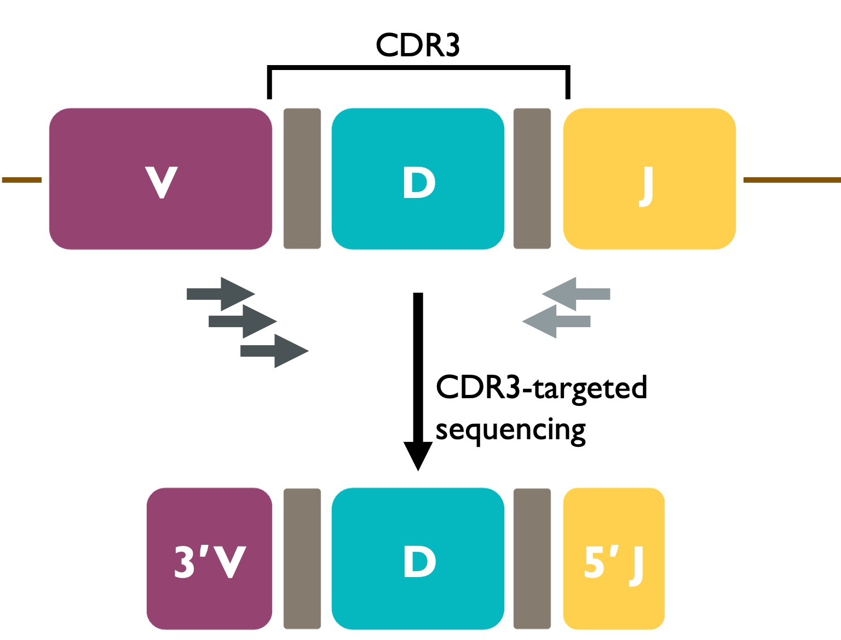
AALL1731 randomized study design
3-drug induction
SR-Fav
SR-Avg
SR-High
Undetectable
Detectable
HTS MRD
~20%
~80%
SR chemo
Randomize
Sensitivity ~10⁻⁶
HTS = high throughput sequencing

Slide 28
AALL1731 randomized study design
3-drug induction
SR-Fav
SR-Avg
SR-High
MRD <0.1%
by EOC
EOC MRD
>0.1-<1%
N=13
Randomize
Chemo + Blina
EOC = end of consolidation

Slide 29
AALL1731 randomized study design
3-drug induction
SR-Fav
SR-Avg
SR-High
Undetectable
Detectable
SR chemo
~20%
~80%
MRD <0.1%
by EOC
EOC MRD
>0.1-<1%
SR chemo
Randomize
N=13
Randomize
Chemo + Blina

Slide 30
Randomization
SR-AVG
SR-High
Arm A
Arm B
Arm C
Arm D
Standard Consolidation
Standard Consolidation
Intensive mBFM Consolidation
Intensive mBFM Consolidation
Blina cycle 1
Blina cycle 1
Interim Maintenance 1
Escalating MTX
Interim Maintenance 1
Escalating MTX
Interim Maintenance 1
High dose MTX
Interim Maintenance 1
High dose MTX
Blina cycle 2
Blina cycle 2
Delayed
Intensification
Delayed
Intensification
Delayed
Intensification
Delayed
Intensification
Interim Maintenance 2
Escalating MTX
Interim Maintenance 2
Escalating MTX
Interim Maintenance 2
Capizzi MTX
Interim Maintenance 2
Capizzi MTX
Maintenance
Maintenance
Maintenance
Maintenance
MTX = methotrexate
Blinatumomab cycle
15mcg/m²/day x 28 days via continuous IV infusion

Slide 31
Study design
Primary aim: Improved disease-free survival (DFS) due to addition of 2 cycles of blinatumomab
  1:1 randomization stratified by risk group and Down syndrome
June 30, 2024 - reached first interim efficacy monitoring point (40% of expected events)
  1,440 patients randomized (64% of planned)
Based on these interim data, DSMC recommended early termination of randomization

Slide 32
AALL1731 NCI SR B-ALL Patients
4236 Eligible
1635 SR-Fav
4018 Stratified
1418 SR-AVG
916 SR-High
1231 Eligible for Randomization
861 Eligible for Randomization
835 Randomized
605 Randomized
418 Chemo Only
Arm A
417 Blina + Chemo
Arm B
304 Chemo Only
Arm C
301 Blina + Chemo
Arm D

Slide 33
Features of randomized patients
 | SR-AVG |  | SR-High
Characteristic | Chemo Only (N=418) | Blina + Chemo (N=417) | Chemo Only (N=304) | Blina + Chemo (N=301)
Median age (range) - years | 4.3 (1.0-10.0) | 4.0 (1.0-9.9) | 4.2 (1.1-9.9) | 4.6 (1.0-10.0)
Median WBC - x10⁹/L | 7.5 (0.0-49.7) | 7.7 (0.3-49.7) | 7.4 (0.6-49.8) | 8.8 (0.4-47.8)
Sex – N (%)
Female | 195 (46.7%) | 207 (49.6%) | 137 (45.1%) | 143 (47.5%)
Male | 223 (53.3%) | 210 (50.4%) | 167 (54.9%) | 158 (52.5%)
Race/ethnicity – N (%)
Hispanic | 104 (24.9%) | 100 (24.0%) | 84 (27.6%) | 84 (27.9%)
Non-Hispanic Asian | 19 (4.5%) | 20 (4.8%) | 10 (3.3%) | 13 (4.3%)
Non-Hispanic Black | 20 (4.8%) | 26 (6.2%) | 18 (5.9%) | 16 (5.3%)
Non-Hispanic White | 213 (51.0%) | 217 (52.0%) | 140 (46.1%) | 156 (51.8%)
Other/Unknown | 62 (14.8%) | 54 (12.9%) | 52 (17.1%) | 32 (10.6%)

Slide 34
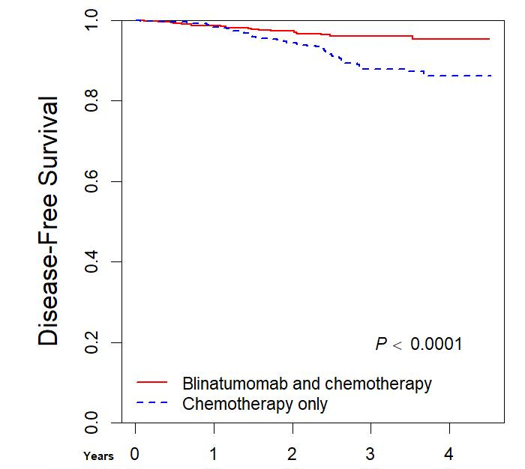
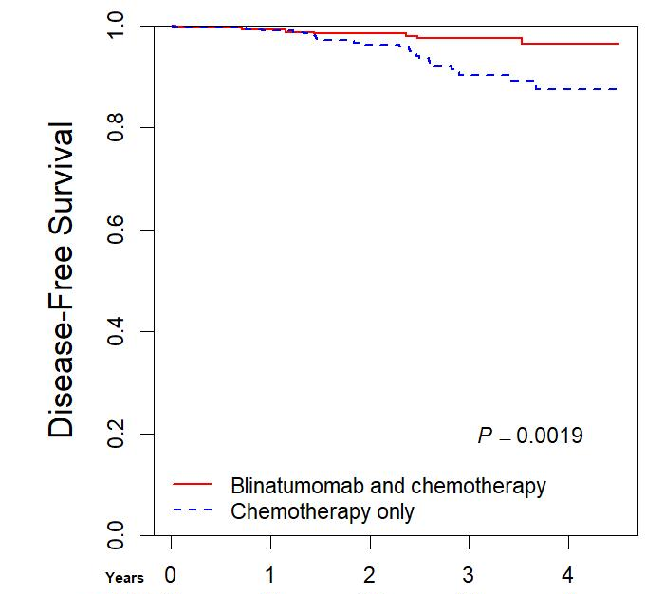
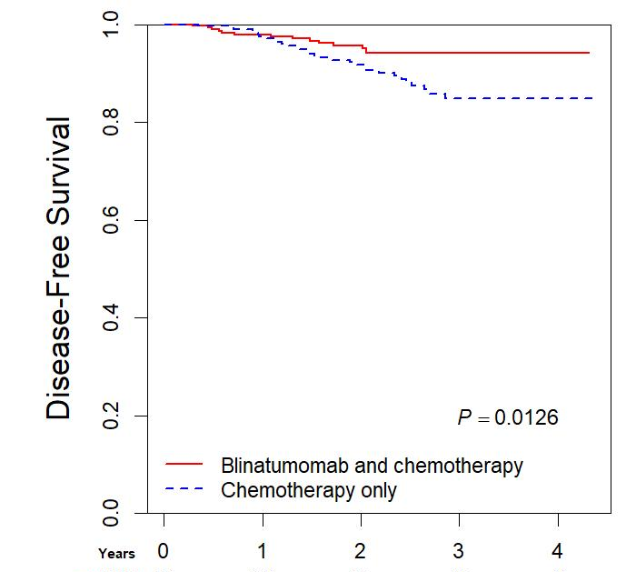
Blinatumomab significantly improves DFS
Overall cohort
SR-Avg
SR-High
Blina + Chemo
Blina + Chemo
Blina + Chemo
Chemo only
Chemo only
Chemo only
P<0.0001
P=0.002
P=0.01
Years
Years
Years
3-yr DFS 87.9 vs 96%
Hazard ratio (HR) 0.39
3-yr DFS 90.2 vs 97.5%
HR 0.33
3-yr DFS 84.8 vs 94.1%
HR 0.45
© The New England Journal of Medicine (2024)

Slide 35
A word on the use of hazard ratios
Tests of the PH assumption revealed weak evidence of violation of assumption
  Wald test of time-varying interaction (p=0.048)
  Generalized least squares score test of non-zero slopes of Schoenfield residuals (p=0.03)
No crossing of DFS curves
Treatment effect may have had a small delay before sustained and strengthening effect took hold

Slide 36
A word on the use of hazard ratios
Nonetheless, for publication we used RMSTs instead (free from PH assumption)
Present HRs in this presentation for ease of interpretation

Slide 37
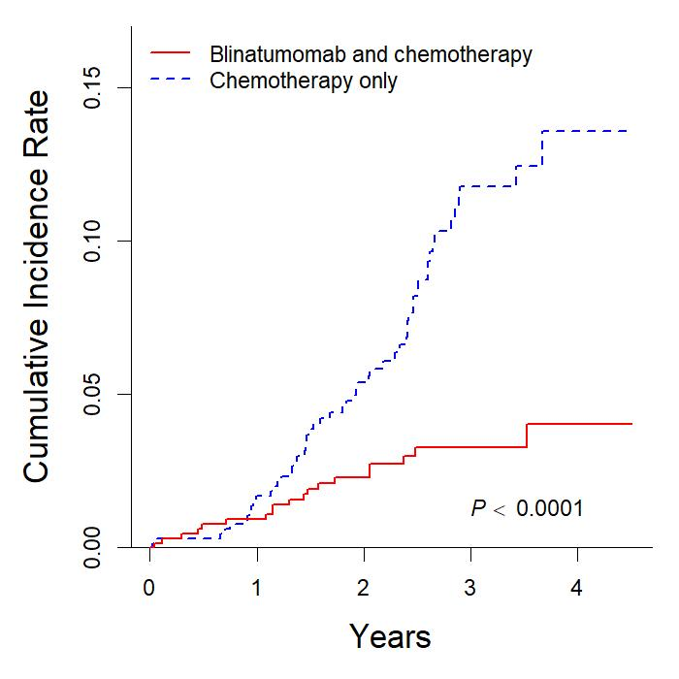
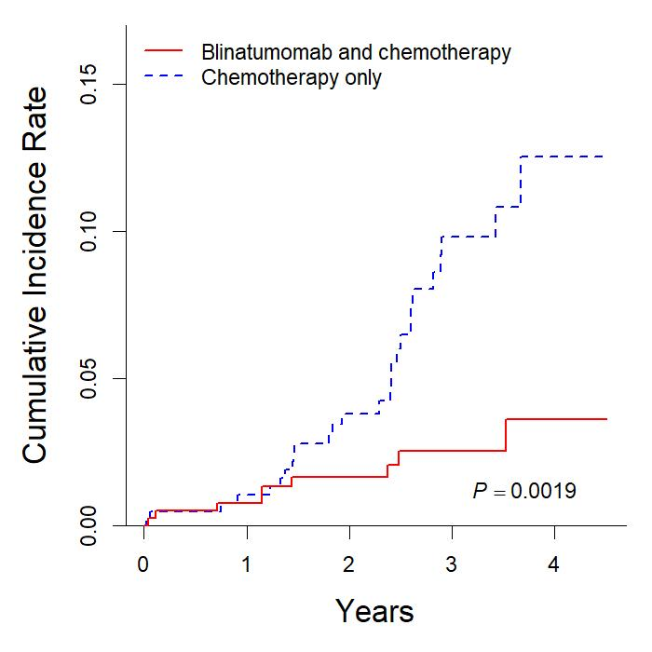
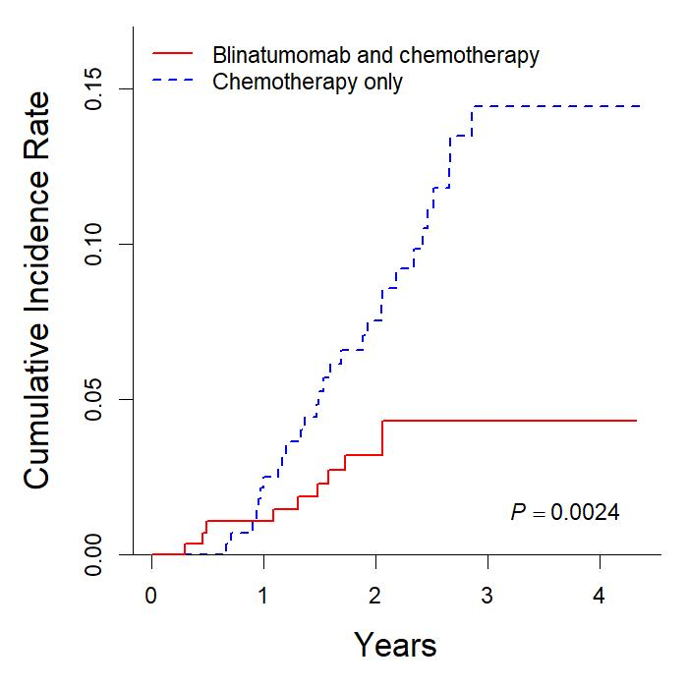
Blinatumomab reduces relapses
Overall cohort
SR-Avg
SR-High
Chemo only
Chemo only
Chemo only
Blina + Chemo
Blina + Chemo
Blina + Chemo
P<0.0001
P=0.002
P=0.002
© The New England Journal of Medicine (2024)

Slide 38
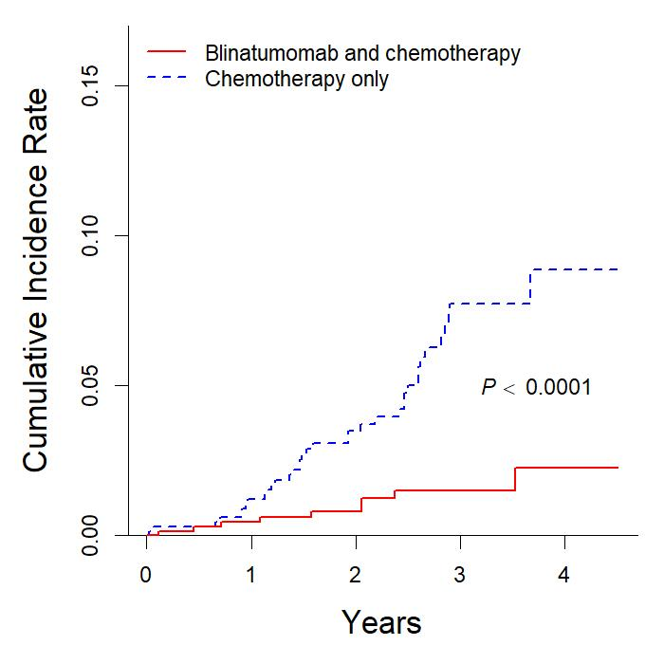
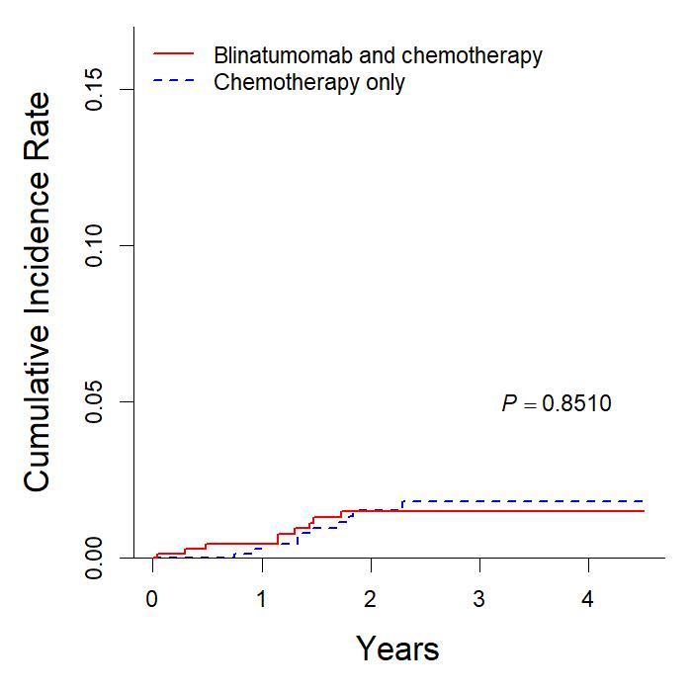
Blinatumomab reduces marrow but not isolated CNS relapses
Isolated marrow relapses
Isolated CNS relapses
Chemo only
P<0.0001
P=0.85
Blina + Chemo
Chemo only
Blina + Chemo

Slide 39
Blinatumomab benefits across subgroups
Subgroup
Blina + Chemo
Event %
Chemo Only
Event %
Hazard Ratio for DFS (95% CI)
All Patients 3.2% 8% 0.39 (0.24-0.64)
Female 2.3% 8.7% 0.27 (0.12-0.59)
Male 4.1% 7.4% 0.52 (0.28-0.97)
Hispanic 4.3% 14.4% 0.29 (0.13-0.69)
Non-Hisp. Asian 3.0% 3.4% 0.96 (0.06-15.3)
Non-Hisp Black* 0.0% 5.3%
Non-Hisp. White 4.1% 7.4% 0.52 (0.28-0.97)
Favorable genetics 1.5% 5.2% 0.29 (0.08-1.02)
Neutral genetics 3.3% 8.0% 0.41 (0.22-0.74)
Unfavorable genetics 7.8% 18.3% 0.40 (0.14-1.14)
EOI MRD<0.01% 2.4% 6.6% 0.36 (0.18-0.71)
EOI MRD>0.01% 4.5% 10.4% 0.44 (0.22-0.86)
Blina better
Chemo better
* Number precludes calculation of Hazard ratio

Slide 40
Low incidence of blinatumomab specific toxicities
 | Blina Cycle 1 (N=624) |  | Blina Cycle 2 (N=552)
 | Grade 2+ | Grade 3+ | Grade 2+ | Grade 3+
Cytokine release syndrome | 18 (2.9%) | 2 (0.3%) | 9 (1.6%) | 0 (0.0%)
Seizure | 9 (1.4%) | 5 (0.8%) | 5 (0.9%) | 4 (0.7%)
Encephalopathy | 1 (0.2%) | 1 (0.2%) | 0 (0.0%) | 0 (0.0%)

Slide 41
Grade 3+ sepsis/catheter related infections SR-Avg
~12-14months
Sepsis Grading
Grade 3: “Blood culture positive with signs or symptoms; treatment indicated”
Grade 4: “Life-threatening consequences; urgent intervention indicated”
Grade 5: “Fatal”
*No difference in rates of Grade 4 or 5 infectious toxicity

Slide 42
Conclusions
Blinatumomab added to chemotherapy significantly improves DFS in NCI SR B-ALL of average and higher relapse risk
Blinatumomab reduces the risk of marrow involving relapses
While overall well tolerated, blinatumomab was associated with higher rates of subsequent sepsis and catheter related infections
Blinatumomab added to chemo represents a new treatment standard

Slide 43
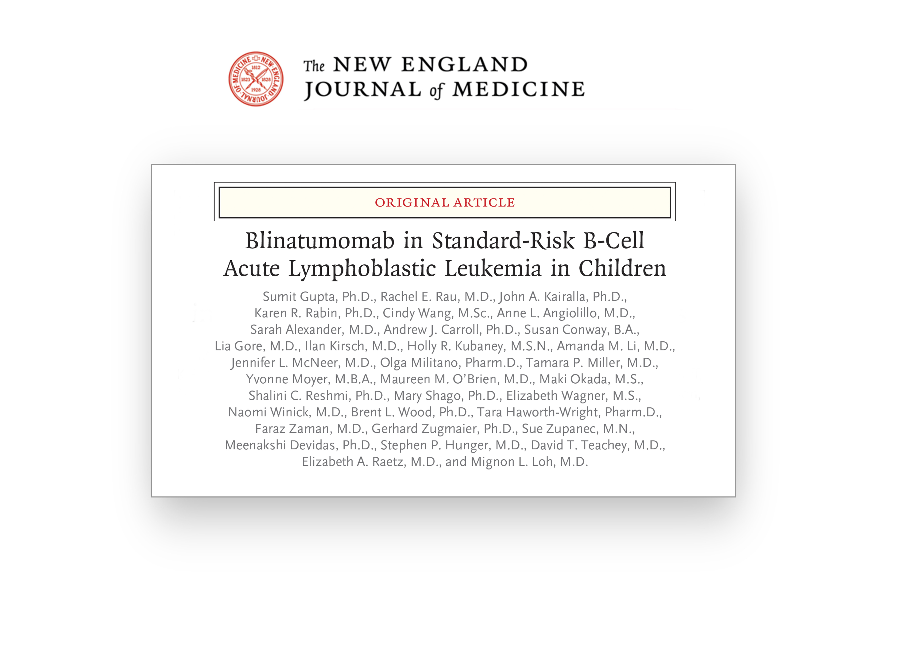
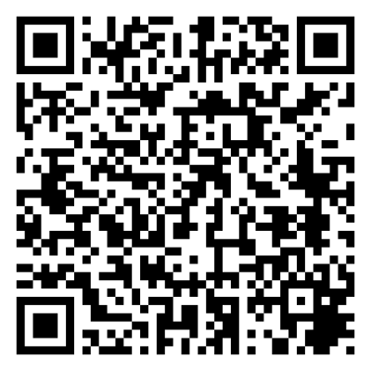

Slide 44
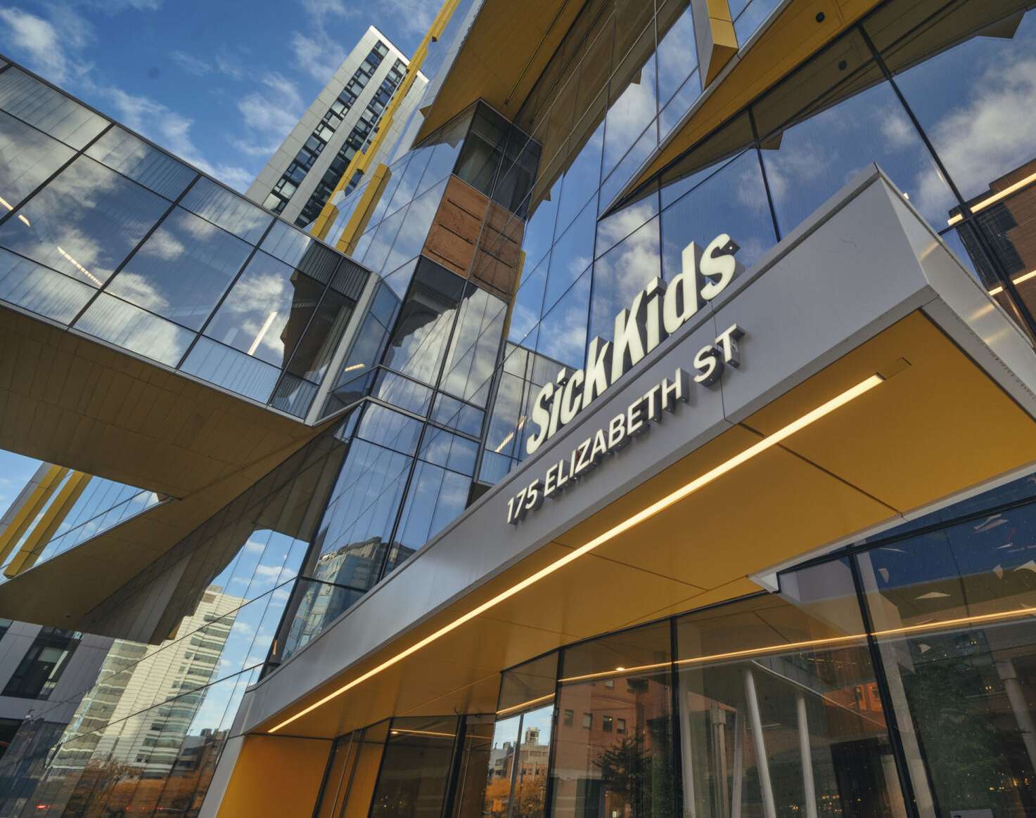
Generalizability to Other Groups

Slide 45
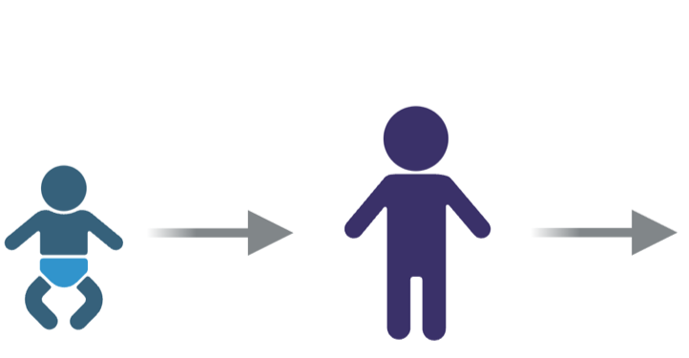
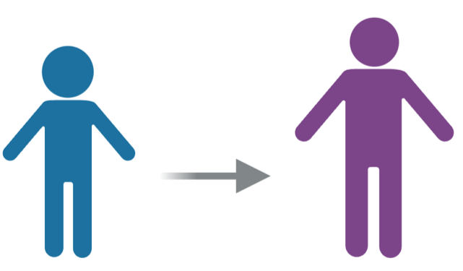

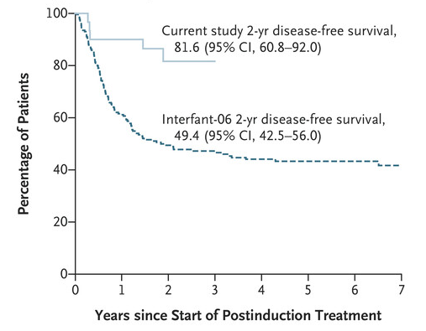
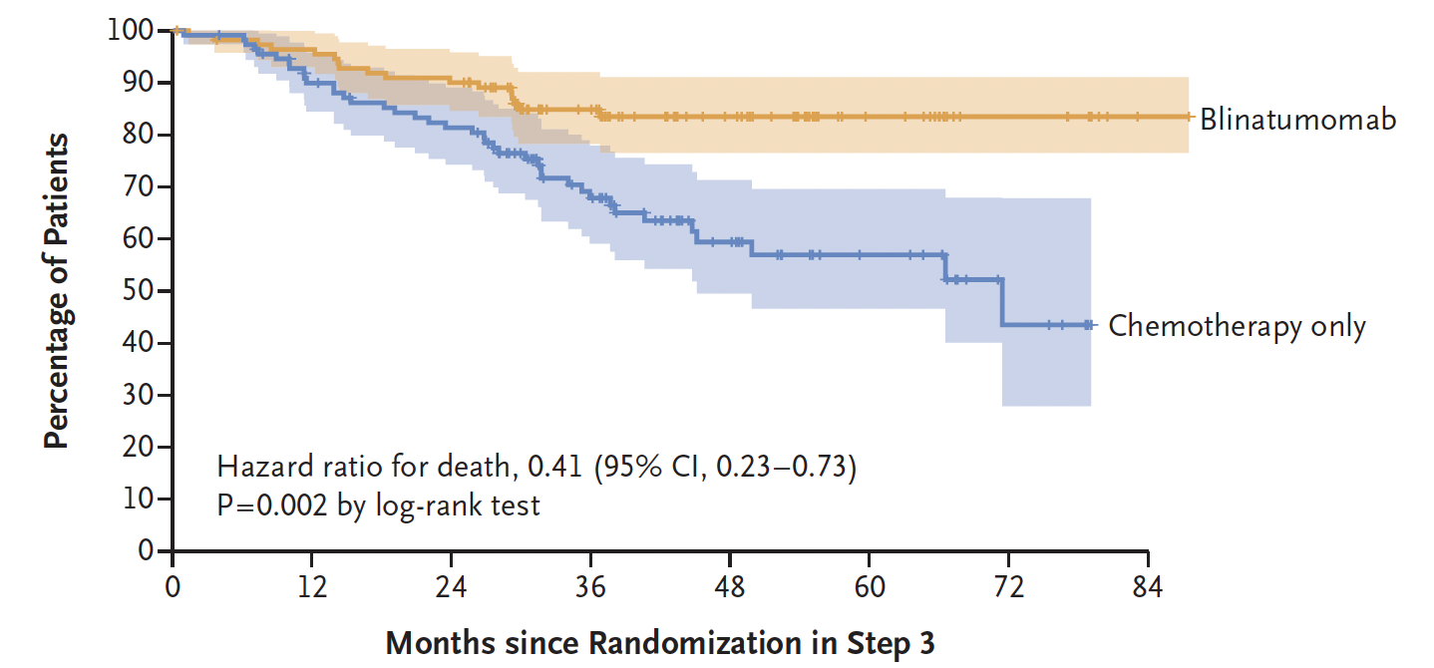
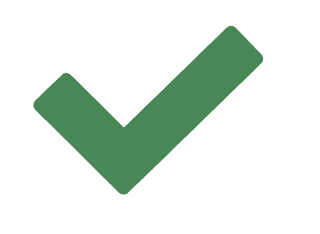
Blinatumomab benefits across age and risk groups
Adult
NCI HR
NCI SR
Infant
Blina + Chemo
Blina + Chemo
Blina + Chemo
Chemo only
Chemo only
?
Chemo only
P<0.0001
van der Sluis et al. NEJM 2023
AALL1731 data
Litzow et al. NEJM 2024

Slide 46
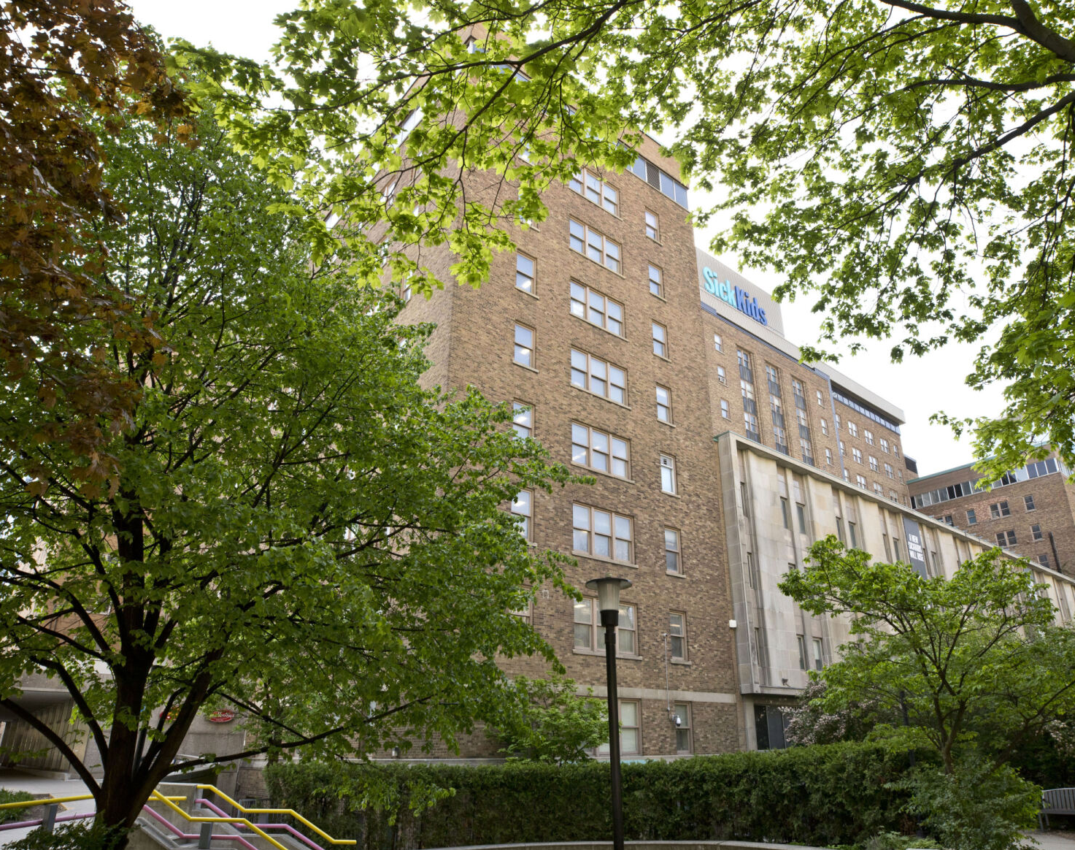
Unanswered Questions

Slide 47
1. How many cycles of blinatumomab are required?
Adult
NCI HR
NCI SR
Infant
Blina + Chemo
Blina + Chemo
Blina + Chemo
Chemo only
Chemo only
?
Chemo only
P<0.0001
van der Sluis et al. NEJM 2023
AALL1731 data
Litzow et al. NEJM 2024
1
2
4

Slide 48
2. Are there other kids who do not need blina?
SR-Fav B‑ALL Arm
SR-Average B-ALL
SR-High B-ALL
SR Consolidation
SR Consolidation
NCI SR B-ALL patients who were EOI HTS MRD negative may have outcomes as good as SR-Favorable (retrospective data)
SR-Average, if D29 M HTS MRD negative, assigned to standard therapy to prospectively verify the anticipated outstanding outcome
Data not yet available
HR Consolidation
EOC¹⁰ MRD
≥1%
Off protocol therapy
HTS EOI MRD
undetectable
HTS EOI MRD
detectable/indeterminate/unavailable
<0.1%
0.1-0.99%
Randomization
Randomization
SR-Avg
Control Arm A
SR- Avg
Exp Arm B
SR-High
Control Arm C
SR-High
Exp Arm D
Blina Block 1
Blina Block 1
Interim
Maintenance I
EscMTX
Interim
Maintenance I
EscMTX
Interim Maintenance I
EscMTX
Interim
Maintenance I
HDMTX
Interim Maintenance I
HDMTX
Blina Block 2
Blina Block 2
Delayed
Intensification
Delayed
Intensification
Delayed Intensification
Delayed
Intensification
Delayed Intensification
Interim
Maintenance II
EscMTX
Interim
Maintenance II
EscMTX
Interim
Maintenance II
EscMTX
Interim
Maintenance II
CMTX
Interim
Maintenance II
CMTX
Maintenance
Maintenance
Maintenance
Maintenance
Maintenance
Wood et al. Blood. 2018

Slide 49

Unanswered Questions
Why are there still a small number of relapses? Do our traditional prognosticators still apply? Will there be new ones?
Who is at highest risk of toxicities like CRS and neurotoxicity? Is the increased infectious risk because of hypogammaglobulinemia? Can that risk be mitigated by the use of IVIG
What happens with longer follow up?
Is blina-containing relapse therapy or CAR-T cells effective when patients have seen blinatumomab up front?

Slide 50

7. How do we decrease barriers to access?
Huge logistical burden for families and cost to either caregivers or healthcare systems
Access to children in remote/rural areas? From families with limited resources?
Access to low- and middle-income countries?

Slide 51

8. De-intensification: Can we take away (some) chemo?
Evidence from elderly adults with ALL as well as from children with toxicity who received bridging chemo (Hodder et al, JCO, 2024)
Which chemo do we take away? What about agents with CNS activity?
Will require well-designed studies that are acceptable to healthcare providers and families
The next COG SR B-ALL trial will study deintensification, focusing on DI and Maintenance pulses
The next COG DS-High trial will study an immunotherapy-heavy/chemo-light regimen that relies on blina and InO

Slide 52
Acknowledgements
Mignon Loh and Elizabeth Raetz
John Kairalla, Cindy Wang, Mini Devidas
Karen Rabin and Anne Angiolillo
Susan Conway
Holly Kubaney, Maki Okada and Sue Zupanec
Rachel Vasquez, Christine Petrossian, Sarah Vargas
Olga Militano and Tara Wright
Shalini Reshmi, Yvonne Moyer, Beth Wagner, Adam Poschner, entire BPC team
Mary Shago and Drew Carroll
Brent Wood and Mike Borowitz
Naomi Winick, Amanda Li, Birte Wistinghausen, Kaitlin Devine, Pat Brown, Jen McNeer, Maureen O’Brien
Sarah Alexander, Tamara Miller, Kira Bona, Lisa Jacola, Julie Brackett
Mary Beth Sullivan and Michael Thomas
Dave Teachey and Steve Hunger
Doug Hawkins, Lia Gore, Peter Adamson, Susan Blaney
Lanny Kirsch and entire Adaptive team
Faraz Zaman, Gerhard Zugmaier, and entire Amgen team
Malcolm Smith and all at NCI CTEP
NCTN Operations Center Grant (U10CA180886)
NCTN Statistics & Data Center Grant (U10CA180899)
St. Baldrick’s Foundation

Slide 53

Acknowledgements
Every site that opened AALL1731
Every patient, parent, and guardian who considered AALL1731

Slide 55

QUESTIONS?

